Slide 1
Data Structures & Algorithms
Week 01

Slide 2
Data Structures and Algorithms
Introduction to Course
Review
Concept of Data Structure
Introduction to Data Structure and its types
Introduction to Algorithm

Slide 3
Introduction to Course
Evaluation Scheme
Topics
ADT
Link List
Sorting
Recursion
Tree
Heap
Hashing
Adv. Searching & Sorting
Graphs
Evaluation/Assesment
Assignments 2 x 10
Quiz 10
Midterm 2 x 15
Final 50

Slide 4
Introduction to Course {Contd..}
Books and References
Data Structures using C and C++ - Y. Langsam, M.J. Augenstein A.M. Tenembaum
Data Structures and Algorithms in C - Brijendra Kumar Joshi
Data Structures - Seymour Lipschutz
Introduction to Algorithms - T.H. Cormen et. al.
Lecture Notes and Slides - Manish Aryal

Slide 5
Data Structure
Definition
Data may be organized in many different ways
The logical or mathematical model of particular organization of data is called as a Data Structure
In other words, a Data Structure may be defined as a way of organizing a collection of Data
Some of the types of data structure are:
Array
List/Linked List
Stack/Queue
Tree
HashMap
The same collection of data may be represented by several data structures so there is a choice

Slide 6
Data Structure {Contd..}
Definition
Different names are used for representing the elements of a data structure
Some commonly used terms are:
data elements, data item, item aggregate, record, node, data object
We will be using record when discussing files and the term node when discussing linked lists, trees and graphs

Slide 7
Data Structure {Contd..}
Different Representations
t
y
p
e
s
t
y
p
e
s
t
p
y
e
s
Data: types

Slide 8
Data Structure {Contd..}
Operations
Data appearing in our data structures are processed by means of certain operations
The particular data structure that one chooses for a given situation depends largely on the frequency with which specific operations are performed

Slide 9
Data Structure {Contd..}
Operations
Following four operations play major role
Traversing: accessing each record exactly once so that certain items in the data structure is processed
Searching: finding the location of the record with a given key value, or finding the location of all records which satisfy one or more condition
Inserting: adding a new record to the data structure
Deleting: removing a record from the data structure

Slide 10
Data Structure {Contd..}
Operations
Some times two or more operations may be used in given situation
Example: we may want to delete the record which may mean we first need to search the location of the record
Following two operations, which are used in special situations, will also be considered:
Sorting: arranging records in some logical order
Merging: combining the records in two different data structures

Slide 11
Algorithm
Necessity
Recipe
Flat pack furniture
Music score
Knitting pattern
What are the common features of these?

Slide 12
Algorithm {Contd..}
Definition
Solution to a problem
Systematic instructions on a task
Step-wise form
Makes use of sequence, selection, iteration, recursion
Language and details agent specific

Slide 13
Algorithm {Contd..}
Definition
Step-by-step procedure used to solve a problem
These steps should be capable of being performed by a machine
Must eventually stop and so produce an answer

Slide 14
Algorithm {Contd..}
Different Algorithms for Same Problem
Devise an algorithm to find the solution to a number raised to a positive power
eg 4⁵ or 10 ³ ie number ^{power}
set answer to 1
Loop 1 to power times
2.1 answer becomes answer * number
3 report answer
Notice the layout and numbering

Slide 15
Algorithm {Contd..}
Different Algorithms for Same Problem
2 ⁵
3 ⁴
1 Set answer to 1
2 Loop for 1 to 5 times
2.1 answer becomes answer * 2
3 Report answer
Set answer to 1
Loop for 1 to 4 times
2.1 answer becomes answer * 3
3 Report answer
Answer Loop
1 1
2 2
4 3
8 4
16 5
32 ?
Answer Loop
1 1
3 2
9 3
27 4
81 ?

Slide 16
Algorithm {Contd..}
Different Algorithms for Same Problem
Devise an algorithm to find the solution to a number raised to a positive power
eg 4⁵ or 10 ³ ie number ^{power}
4⁵ = 4 ² * 4 ² * 4 ¹
= 16 * 16 * 4
= 1024

Slide 17
Algorithm {Contd..}
Different Algorithms for Same Problem
1 Set answer to 1, num to number, value to power
2 Loop while value is positive
2.1 if value is odd then multiply answer by num
2.2 divide value by 2 ignore remainder, multiply num by itself
3 Report answer
2 ⁵
3 ⁴
answer num value
1 2 5
2 4 2
2 16 1
32 0
answer num value
1 3 4
1 9 2
1 81 1
81 0

Slide 18
Review {Contd..}
Conditions Control Statements:
if statements, nested if statements, and switch statements
Looping Statements:
while loop, do … while loop and for loop
for loop
Functions:
Function Prototype, function Call, function definition

Slide 19
Review {Contd..}
Operator Precedence (highest to lowest)
Operator | Associativity
( ) ++ - - | Left to right Right to left
++ - - ! Unary + Unary – (cast) sizeof | Right to left Right to left
* / % | Left to right
+ - | Left to right
< <= > >= | Left to right
= = != | Left to right
&& | Left to right
| | | Left to right
? : | Right to left
= + = - = * = / = | Right to left

Slide 20
Review {Contd..}
Arrays
One-dimensional array
DataType ArrayName[ConstIntExpression] ;
Two-dimensional array
DataType ArrayName[ConstIntExpression][ ConstIntExpression] ;
↑ ↑
Rows Columns
Three-dimensional array
DataType ArrayName[ConstIntExpression][ConstIntExpression][ConstIntExpression] ;
↑ ↑ ↑
Pages Rows Columns

Slide 21
Review {Contd..}
Pointers
Variable that stores address
Data type *ptr var
Examples:
short np, *p, **pp, ***ppp; //np is non-pointer vairable
p = &np; //p is pointer variable which has address of np
pp = &p; //pp is pointer variable which has address of p
ppp = &pp; //ppp is pointer variable which has address of pp
↑ ↑ ↑ ↑
ppp pp p np

Slide 22
Review {Contd..}
Structures
Class Declaration:
class Str_Name //Define structure name and members
{
private:
DataType MemberName; //Define structure member
DataType MemberName; //Define structure member
StructType MemberName; //Define structure member
public:
set();
get();
. . .
};

Slide 23
Review {Contd..}
Pseudocodes
Pseudocode = English + Code
relaxed syntax that extended version of the
is easy to read basic control structures
(sequential, conditional, iterative)

Slide 24
Review {Contd..}
Pseudocodes
Algorithm Header
Algorithm Body

Slide 25
Review {Contd..}
Pseudocodes
Algorithm Header:
Name
Parameters and their types
Purpose
what the algorithm does
Precondition
precursor requirements for the parameters
Postcondition
taken action and status of the parameters
Return condition
returned value

Slide 26
Review {Contd..}
Pseudocodes
Algorithm Body:
Statements
Statement numbers
decimal notation to express levels
Variables
important data
Algorithm analysis
comments to explain salient points
Statement constructs
sequence, selection, iteration

Slide 27
Review {Contd..}
Pseudocode Example
Algorithm average
Pre nothing
Post numbers read and their average printed
1 Declare i as integer
2 Set i = 0
3 loop until all data not read
3.1 i = i + 1
3.2 read number
3.3 sum = sum + number
3.4 Repeat step 3 OR Goto step 3
4 average = sum / i
5 print average
6 return
End average

Slide 28
Rule of Three
If a class define any of the following, then it should probably explicitly define all three:
Destructor
Copy Constructor
Copy Assignment operator

Slide 29
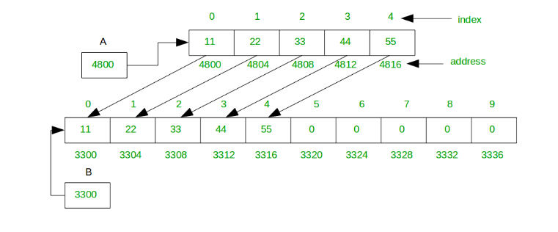
Dynamic Array
Grow and Shrink

Slide 30
Grow
int main(){
int i;
int* array = NULL;
array = new int[5];
for(i=0;i<5;i++){
array[i]=i+1;
}
array = new int[10];
for(i=5;i<10;i++){
array[i]=i+1;
}
for(i=0;i<10;i++){
cout<<array[i];
}
return 0;
}

Slide 31
Dynamic Array
Grow and Shrink

Slide 32
Grow
int main(){
int i;
int* array = NULL;
array = new int[5];
for(i=0;i<5;i++){
array[i]=i+1;
}
temp = new int[10];
for(i=5;i<10;i++){
array[i]=i+1;
}
for(i=0;i<10;i++){
cout<<array[i];
}
return 0;
}
int* temp = new int[capacity];
// copy element of old array in newly created array
for (int i = 0; i < size; i++) {
temp[i] = array[i];
}
// Delete old array
delete[] array;
// Assign newly created temp array to original array
array = temp;

Slide 33
Shrink
CREATE SIMILAR LOGIC

Slide 34
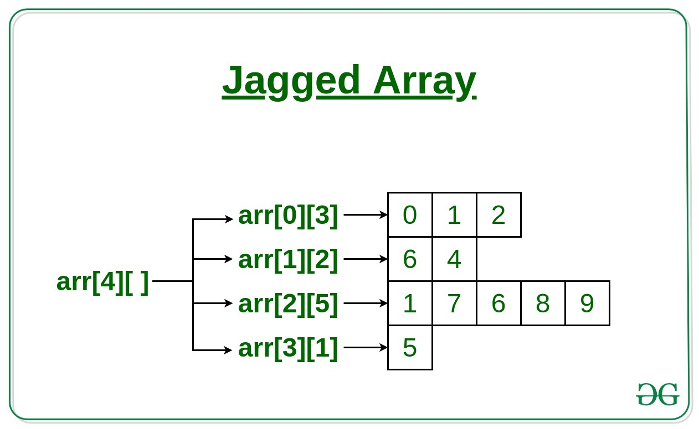
Jagged Array
Also known as a ragged array or irregular array.
An array of arrays of which the member arrays can be of different lengths, producing rows of jagged edges when visualized as output.

